Slide 1

PROJECT - VISIBILITY PREDICTION FOR AIR TRAFFIC CONTROL
PREPARED BY - YATRIK SHAH
SCHOOL OF EMERGING SCIENCE AND TECHNOLOGY
GUJARAT UNIVERSITY

Slide 2
PRESENTATION WORKFLOW
ABSTRACT
INTRODUCTION
DATA DESCRIPTION
WORKFLOW STEPS
METHODOLOGY
REAL LIFE APPLICATIONS
EXPECTED OUTCOME
DEPLOYMENT LINK
REFERENCES

Slide 3
ABSTRACT
In today’s world of globalization, the problem of human safety is increasing day by day due to absorption of light to reduce the clarity and colours of what you see. This affects the visibility in the environment and it goes down. Many factors can cause visibility in the environment like haze, air pollution, climate change etc. Considering this, I have decided to make the machine to predict the level of visibility in the environment taking various features like temperature, wind speed, humidity etc. It becomes very important in cities like Delhi, where the air pollution remains at peak level, or the cities where there is high amount of haze which can cause the air traffic problem. My model will predict the level of visibility level in the environment so we can avoid these problems before it arise.

Slide 4
INTRODUCTION
Visibility is a measure of the distance at which an object or light can be clearly perceived. We predict the visibility of an object from a particular distance in kilometers on the basis of: Dry Bulb Temp, Wet Bulb Temp, Relative humidity and many more. Visibility is affected by certain environmental factors and may vary according to the direction and angle of view and the height of the observer.

Slide 5
REAL-LIFE APPLICATIONS
Key value in deciding if the flight would take off or land or not.
Flight's Visibility is an important factor in all phases of flight, but especially when an aircraft is manoeuvring on or close to ground, at that time weather has to be clear in order to avoid accidents.
Also a very important value in knowing distance from the land while docking a ship at a dockyard.
Car Racing is not allowed if there isn't proper visibility.
Useful in day-to-day life as well while driving vehicles.

Slide 6
DATA DESCRIPTION
VISIBILITY - Distance from which an object can be seen.
DRYBULBTEMPF-Dry bulb temperature (degrees Fahrenheit). Most commonly reported standard temperature.
WETBULBTEMPF-Wet bulb temperature (degrees Fahrenheit).
DewPointTempF-Dew point temperature (degrees Fahrenheit).
Relative Humidity-Relative humidity (percent).
Wind-Speed-Wind speed (miles per hour).
WindDirection-Wind direction from true north using compass directions.
StationPressure-Atmospheric pressure (inches of Mercury; or ‘in Hg’).
SeaLevelPressure- Sea level pressure (in Hg).
PreciP Total-precipitation in the past hour (in inches).

Slide 7
WORKFLOW-STEPS
Raw Data collection
Data pre-processing
Eda and data visualization
Feature engineering
LOGGING
Maintain training data in database
Cross validation and hyper parameter tuning
Model selection
Prediction data base maintaining
Creating api
Integrating with WEB FRAMEWORK - flask
Model deployment

Slide 8
DATA PRE-PROCESSING & EDA
Observation – As a first step, the data was observed and all the features were taken into consideration.
Null Values – In the dataset, it was checked whether there is the null values or not and if it is, how many records it contains.
Trends and Patterns – Visualized some important graphs and charts to observe the considerable trends and some patterns to know the relationship between the features

Slide 9
FEATURE ENGINEERING
Scaling – Standardization was used as a method of scaling to bring down all the features to a common scale without distorting the differences in the range of the values.
Multi-collinearity – Removed multi-collinearity by creating heatmap of correlation metrics.
Handling null values – Null values was critically observed and it was removed from all the features in the dataset.

Slide 10
LOGGING
Logging is very important in end-to-end projects.
Maintained logs for saving and get informed each and every information, warnings, errors in any program.
Logging is very useful specially in case of program crashing.
It is an essential part of troubleshooting application and infrastructure performance.

Slide 11
MAINTAINED TRAINING DATA IN Database
After data cleaning, exploratory data analysis and feature engineering, dumping the final data for model training in the database.
This data can directly be taken for model training purpose.
MySQL database is maintained.

Slide 12
USED MODELS
1. RANDOM FOREST
As the name suggests, "Random Forest is a classifier that contains a number of decision trees on various subsets of the given dataset and takes the average to improve the predictive accuracy of that dataset." Instead of relying on one decision tree, the random forest takes the prediction from each tree and based on the majority votes of predictions, and it predicts the final output.
The greater number of trees in the forest leads to higher accuracy and prevents the problem of overfitting.

Slide 13
USED MODELS
2. XGBOOST
Extreme Gradient Boosting (XGBoost) is an open-source library that provides an efficient and effective implementation of the gradient boosting algorithm.
Boosting is a sequential technique which works on the principle of an ensemble. It combines a set of weak learners and delivers improved prediction accuracy.
Gradient boosting is a machine learning technique used in regression and classification tasks, among others. It gives a prediction model in the form of an ensemble of weak prediction models, which are typically decision trees.

Slide 14
CROSS-VALIDATION AND HYPER-PARAMETER TUNING
Cross validation and Hyperparameter tuning is one of the most important steps in Machine Learning, since the performance of the machine learning model is affected upon the hyperparameters those are selected for model training.
Performed Cross validation and Hyperparameter tuning on all the models and selected the best models those performs best on the validation sets according to the given parameter grid
Found and selected the best hyperparameters of all the models for model training on Full data

Slide 15
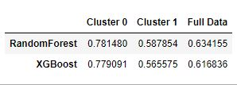
Model Evaluation and Selection
R Squared
Here clustering approach is used. Where Kmeans is used to create the clusters.
Here optimum number of clusters are two. And best parameters are chosen from cross validation and hyperparameter tuning. The evaluation metric R squared is shown in the table above.
Both the clusers are having better accuracy with RandomForest model compared to XGBoost.
So that, RandomForest model is chosen as Final Model.

Slide 16
Creating API
A real-world Data Science based does not end just after successfully building a machine learning model that performs well on the test dataset.
In real-world industrial end-to-end Artificial Intelligence or Data Science based projects creating Front-End API is also having equal importance as back-end tasks like- Model Training or Model Evaluation
The Front-End is created with the help of HTML(Hypertext Markup Language) and CSS(Cascading Style Sheets), which are very powerful tools.
Flask is used as WEB – API in python that integrates back-end and front-end.
Flask depends on the Jinja template engine and the Werkzeug WSGI toolkit.

Slide 17
Model Deployment
Generally Model Deployment is considered as the last step in any Machine Learning project.
After successfully creating front-end API with HTML and CSS and using Flask as web Framework only Model Deployment is left .
Here HEROKU platform is chosen as Model Deployment .
Heroku is a container-based cloud Platform as a Service (PaaS). Developers use Heroku to deploy, manage, and scale modern apps.

Slide 18
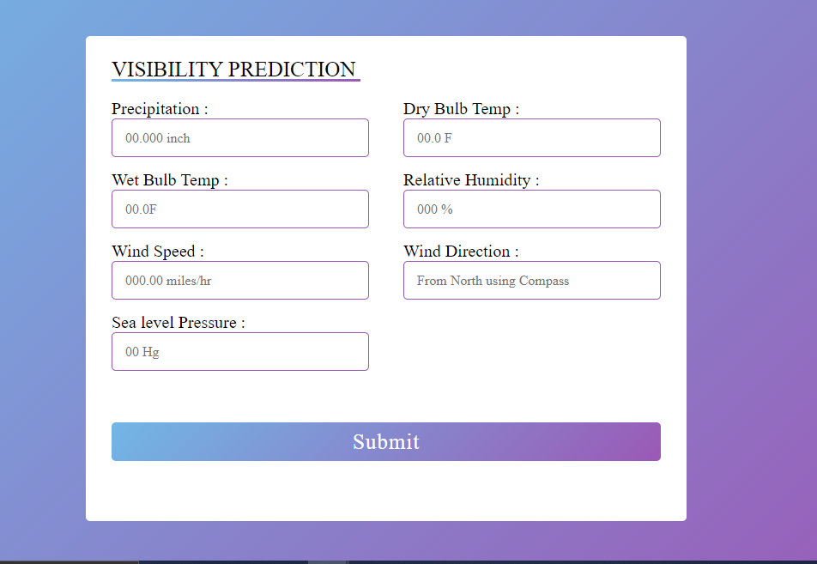
DEPLOYMENT LINK
https://hidden-vision.herokuapp.com/
Glimpse of API

Slide 19
EXPECTED OUTCOME-GOAL
The final outcome or goal is to predict the maximum distance up to which objects can be seen at a particular temperature

Slide 20
REFERENCES
Microsoft Word - MoCA-Final Compendium_23 Dec.docx (civilaviation.gov.in)
Visibility | SKYbrary Aviation Safety
Air traffic control - Wikipedia
GITHUB LINK
Yatrik07/Visibility_Prediction (github.com)

